Slide 1
Unit-3 Cluster Analysis

Slide 2
Outline
Cluster analysis
What is cluster analysis?
Requirements for cluster analysis
Overview of basic clustering methods
Partitioning methods
Hierarchical methods
Density-based methods

Slide 3
Cluster Analysis: A Quick Overview
When flying over a city, one can easily identify fields, forests, commercial areas, and residential areas based on their features, without anyone’s explicit “training”—This is the power of cluster analysis
We systematically study cluster analysis methods and help answer the following:
What are the different proximity measures for effective clustering?
Can we cluster a massive number of data points efficiently?
Can we find clusters of arbitrary shape? At multiple levels of granularity?
How can we judge the quality of the clusters discovered by our system?

Slide 4
Broad Applications of Cluster Analysis
Data summarization, compression, and reduction
Examples: Image processing or vector quantization
Collaborative filtering, recommendation systems, or customer segmentation
Finding like-minded users or similar products
Dynamic trend detection
Clustering stream data and detecting trends and patterns
Multimedia data analysis, biological data analysis, and social network analysis
Examples: Clustering video/audio clips or gene/protein sequences
A key intermediate step for other data mining tasks
Generating a compact summary of data for classification, pattern discovery, and hypothesis generation and testing
Outlier detection: Outliers are those “far away” from any cluster

Slide 5
What is Cluster Analysis?
A cluster is a collection of data objects which are
Similar (or related) to one another within the same group (i.e., cluster)
Dissimilar (or unrelated) to the objects in other groups (i.e., clusters)
Cluster analysis (or clustering, data segmentation, …)
Given a set of data points, partition them into a set of groups (i.e., clusters) which are as similar as possible
Cluster analysis is unsupervised learning (i.e., no predefined classes)
This contrasts with classification (i.e., supervised learning)
What is the value of cluster analysis?
Cluster analysis helps you partition massive data into groups based on its features
Cluster analysis will often help subsequent processes such as pattern discovery, classification, and outlier analysis

Slide 6
Considerations for Cluster Analysis
Partitioning criteria
Single level vs. hierarchical partitioning (often, multi-level hierarchical partitioning is desirable, e.g., grouping topical terms)
Separation of clusters
Exclusive (e.g., one customer belongs to only one region) vs. non-exclusive (e.g., one document may belong to more than one class)
Similarity measure
Distance-based (e.g., Euclidean, road network, vector) vs. connectivity-based (e.g., density or contiguity)
Clustering space
Full space (often when low dimensional) vs. subspaces (often in high-dimensional clustering)

Slide 7
Requirements and Challenges
Quality
Ability to deal with different types of attributes: Numerical, categorical, text, multimedia, networks, and mixture of multiple types
Discovery of clusters with arbitrary shape
Ability to deal with noisy data
Scalability
Clustering all the data instead of only on samples
High dimensionality
Incremental clustering and insensitivity to input order
Constraint-based clustering
User-given preferences or constraints; domain knowledge; user queries
Interpretability and usability

Slide 8
Typical Clustering Methodologies
Distance-based methods
Partitioning algorithms: K-Means, K-Medians, K-Medoids
Hierarchical algorithms: Agglomerative vs. divisive methods
Density-based and grid-based methods
Density-based: Data space is explored at a high-level of granularity and then post-processing to put together dense regions into an arbitrary shape

Slide 9
Clustering Different Types of Data
Numerical data
Most earliest clustering algorithms were designed for numerical data
Categorical data (including binary data)
Discrete data, no natural order (e.g., sex, race, zip-code, and market-basket)
Text data: Popular in social media, Web, and social networks
Features: High-dimensional, sparse, value corresponding to word frequencies
Methods: Combination of k-means and agglomerative; topic modeling; co-clustering

Slide 10
Similarity measures

Slide 11
Similarity measures Introduction:
Clustering is the process of dividing a set of objects into groups or clusters based on their similarities. The similarity between objects is typically measured using a distance or similarity measure.
The choice of distance or similarity measure can greatly impact the clustering results, as different measures can lead to different clusters.
In this topic, we will explore the different distance and similarity measures used in clustering and their impact on the clustering results.
Notes:
Imagine you are a fashion retailer trying to understand the purchasing habits of your customers. By applying clustering techniques to your customer data, you can group together customers who share similar buying patterns, such as those who prefer high-end fashion, those who frequently buy discounted items, or those who favor athletic wear. This can help you to tailor your marketing efforts and product offerings to different customer segments, increasing sales and customer satisfaction.

Slide 12
Similarity measure purpose
Similarity measures in clustering refer to mathematical tools or functions used to quantify how similar or dissimilar two data points are.
These measures determine how data points are grouped together based on their likeness, where points with higher similarity are clustered together.
Common similarity measures include Euclidean distance, Manhattan distance, Cosine similarity, and Jaccard similarity, each suited for different types of data and clustering algorithms.
Depending on the type of data (numbers, categories, or text), you choose different ways to measure similarity. The right similarity measure helps the algorithm find patterns, group similar things together, and make sure the clusters are meaningful and accurate. Choosing the right one is important for getting good results.

Slide 13
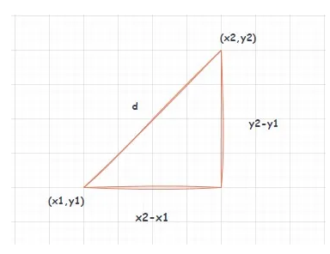
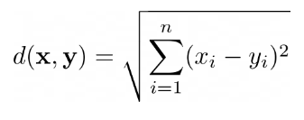

1.Euclidean Distance: Measures the straight-line distance between two points in a multi-dimensional space.
This is the most common distance measure used in clustering. Euclidean distance can be used for data with continuous variables, such as height, weight, or age.
Formula:
Use Cases:
Widely used in algorithms like K-Means and Hierarchical Clustering.
Suitable for numerical and continuous data.
Advantages: Easy to compute, works well with compact, spherical clusters.
Disadvantages: Sensitive to outliers and the scale of features, requires normalization in many cases.

Slide 14
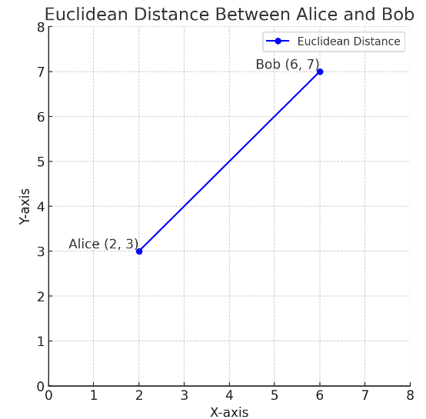
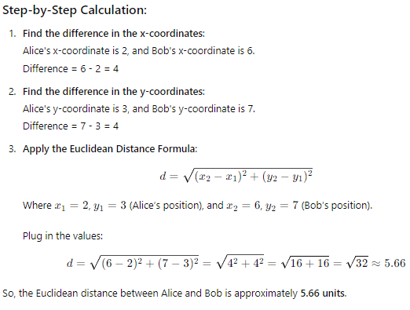
Example Problem on Euclidean Distance:
Let's say we have two friends, Alice and Bob, standing at different locations in a park. Their positions are represented as points on a map:
Alice is standing at position (2, 3).
Bob is standing at position (6, 7).
We want to know the straight-line distance between Alice and Bob.

Slide 15
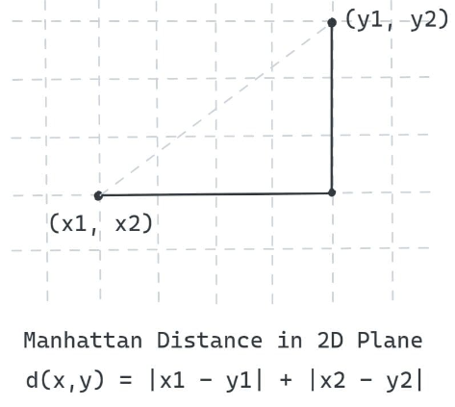
2. Manhattan Distance: This distance measure is also known as city block distance or taxicab distance. Manhattan distance can be used for data with discrete variables, such as the number of bedrooms in a house.
Imagine you're walking in a city with streets laid out in a grid. To get from one point to another, you can't walk through buildings, so you walk along the streets, taking right-angle turns. The Manhattan distance is the total distance you would walk by moving along the grid (like blocks in a city), rather than in a straight line.
Suppose you’re inside a two-dimensional plane and you can move only along the axes as shown:
Use Cases of Manhattan Distance :
Useful when the difference between features is more significant than their absolute distance.
Suitable for grid-like data structures (e.g., in urban planning or logistics).
Advantages: Less sensitive to outliers than Euclidean distance.
Disadvantages: May not be ideal for naturally spherical clusters.

Slide 16
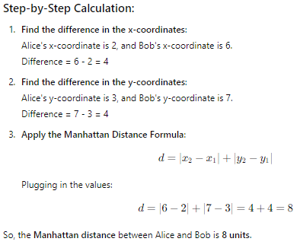
Let's use the same example with Alice and Bob standing at different locations in the park:
Alice is at position (2, 3).
Bob is at position (6, 7).
We want to know the Manhattan distance between them, which is the total number of horizontal and vertical steps required to get from Alice to Bob if we can only move along a grid (like city blocks).

Slide 17
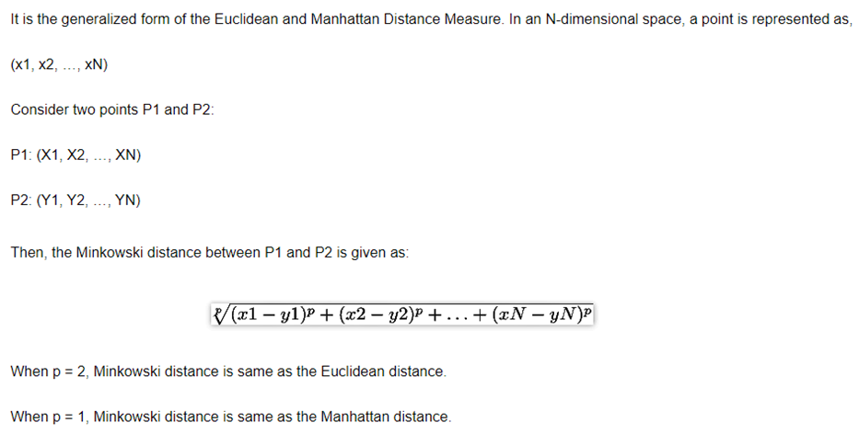
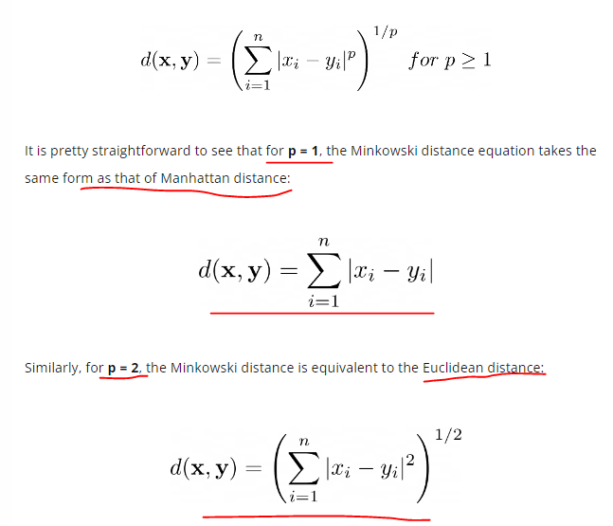
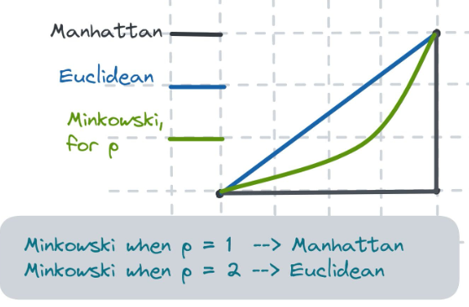
3.Minkowski distance

Slide 18
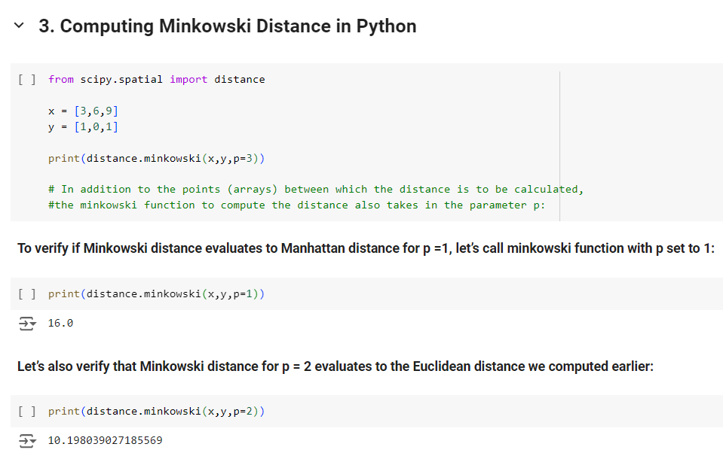

Slide 19
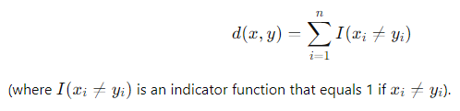
4.Hamming distance
Hamming distance is a metric for comparing two binary data strings. While comparing two binary strings of equal length, Hamming distance is the number of bit positions in which the two bits are different.
Formula:
Use Cases:
Suitable for categorical or binary data.
Often used in clustering of DNA sequences or text mining for binary features.
Advantages: Simple and effective for categorical data.
Disadvantages: Cannot be used for numerical or continuous data.
NOTE: In order to calculate the Hamming distance between two strings, and, we perform their XOR operation, (a⊕ b), and then count the total number of 1s in the resultant string.
Suppose there are two strings 11011001 and 10011101.
11011001 ⊕ 10011101 = 01000100. Since, this contains two 1s, the Hamming distance, d(11011001, 10011101) = 2.

Slide 20
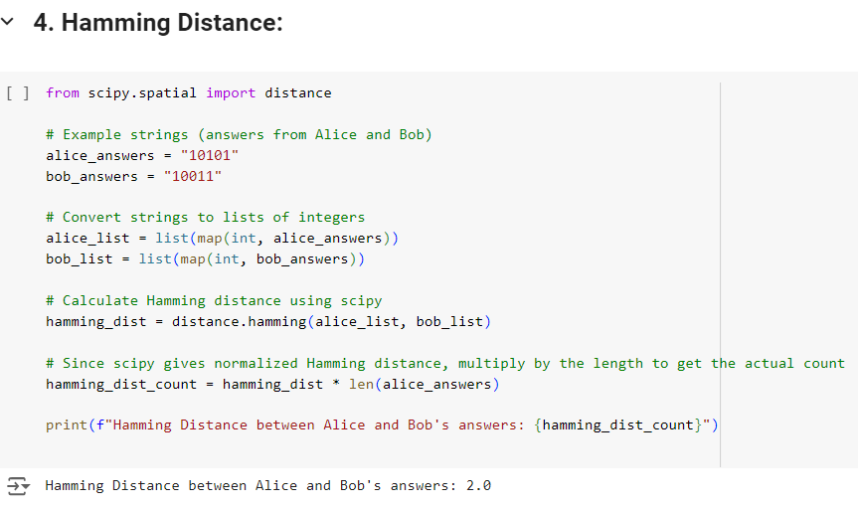

Slide 21

5.Cosine Distance & Cosine Similarity:
Cosine distance & Cosine Similarity metric is mainly used to find similarities between two data points. Measures the cosine of the angle between two non-zero vectors, ignoring magnitude and focusing on direction.
As the cosine distance between the data points increases, the cosine similarity, or the amount of similarity decreases, and vice versa. Thus, Points closer to each other are more similar than points that are far away from each other. Cosine similarity is given by Cos θ, and cosine distance is 1- Cos θ.
Where is it used?
Cosine metric is mainly used in Collaborative Filtering based recommendation systems to offer future recommendations to users.

Slide 22
Cosine Similarity contd.
See how cosine similarity would work in the context of the Telugu movie recommendation system:
Cosine Similarity Example: Cosine similarity measures how similar two sets of preferences are by comparing the angles between their vectors.
For Telugu movies:
User #1 likes romantic movies like Premam and Kshana Kshanam.
User #2 also enjoys romantic movies like Fidaa and Geetha Govindam.
The system calculates the cosine similarity between the movie preferences of User #1 and User #2.
Since both users prefer romantic movies, the cosine similarity score will be high, indicating they have similar tastes.
Consequently, the system will recommend movies liked by User #2 (e.g., Hello and Pelli Sandadi) to User #1.
In contrast, if User #1 prefers horror movies and User #2 prefers romance, their cosine similarity score will be low, suggesting their tastes are quite different. Thus, the system will avoid recommending horror movies to User #2 and will focus on romance movies instead.

Slide 23
Cosine Similarity contd.
Use Cases:
Common in text clustering, like document clustering or topic modeling.
Works well in high-dimensional, sparse data (e.g., word vectors in NLP).
Advantages: Ignores magnitude, making it suitable for text and high-dimensional data.
Disadvantages: Not ideal for data where the magnitude (or length) of vectors is meaningful.

Slide 24
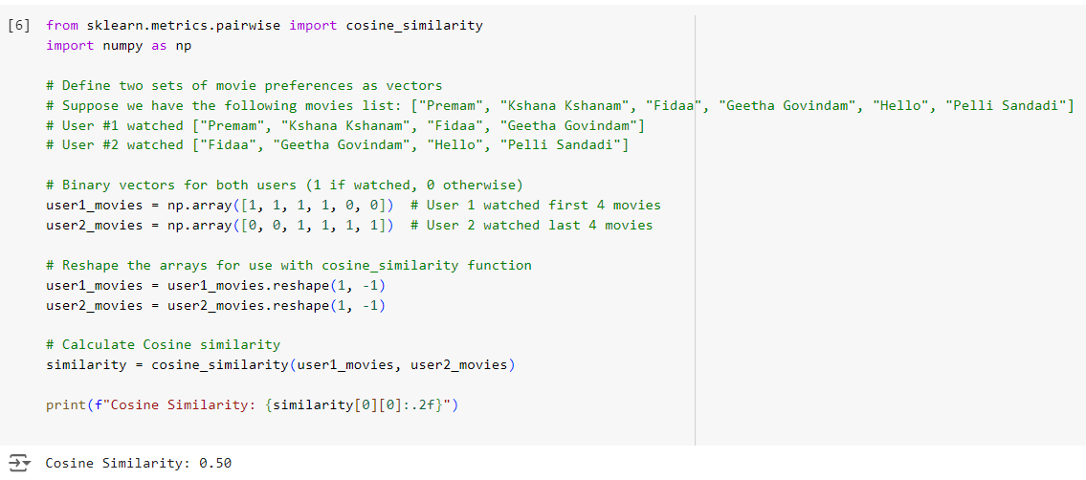
In this case, the Cosine similarity score is 0.50, meaning that User #1 and User #2 have a 50% similarity in their movie preferences.

Slide 25
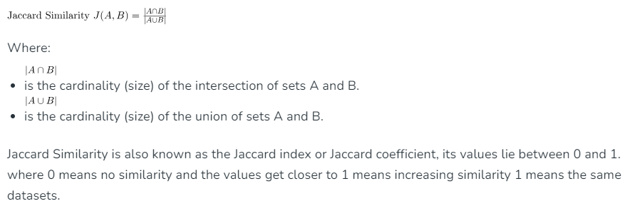
6. Jaccard similarity
The Jaccard similarity is a statistical measure used to compare the similarity and diversity between two sets.
It is defined as the size of the intersection of the sets divided by the size of their union.
For example: Given two sets A and B, their Jaccard Similarity is provided by,

Slide 26
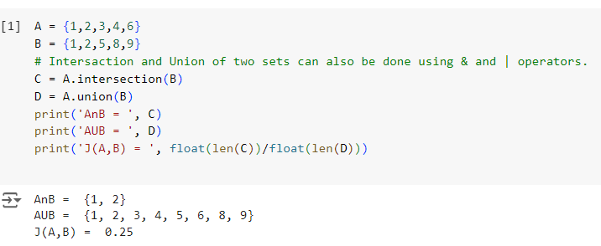
Jaccard similarity contd.

Slide 27
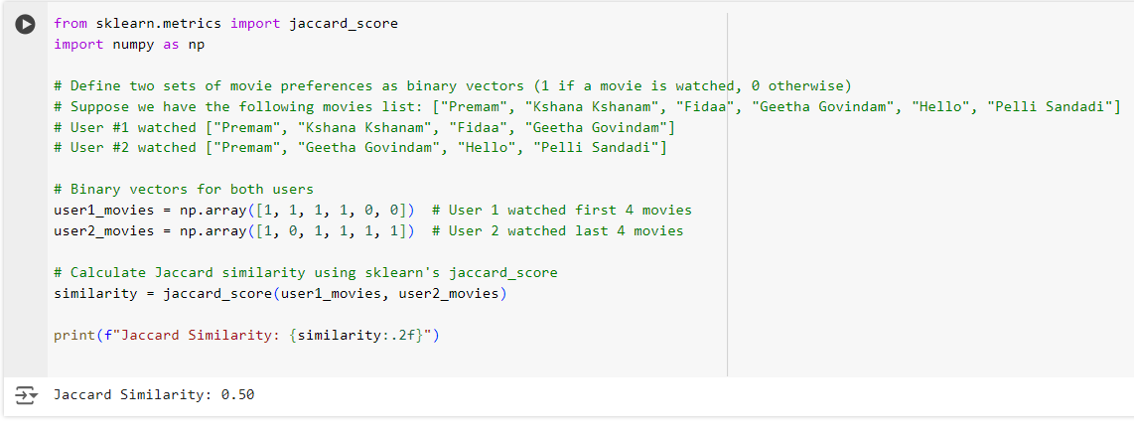

Slide 28
The choice of similarity measure depends on the nature of the data
Numerical data: Euclidean, Manhattan, Minkowski.
Categorical data: Hamming, Jaccard.
Text data: Cosine similarity.
Scaling: Some similarity measures (like Euclidean and Manhattan) require data scaling to
avoid biases from large-scale features.
Outliers: Consider the sensitivity of the similarity measure to outliers.
For instance, Euclidean distance is sensitive to outliers, while Manhattan distance
is less so.
Dimensionality: Cosine similarity works well in high-dimensional spaces,
such as in text or document clustering.

